Slide 1
Unit 7: Light Search and Rescue Operations
CERT Basic Training

Slide 2
Unit 6 and 8 Review
What is P.A.S.S.?
What is L.I.E.S?
A fire extinguisher is effective for what size fire?
T/F You should always shut off the gas after an earthquake.
In an Active Shooter situation, what are three response options?
PM 7-1
CERT Basic Training Unit 7: Light Search and Rescue Operations
7-2
Notes:
Pull, Aim, Squeeze, Sweep
Limit, Isolate, Eliminate, Separate
Average size, not larger than a trash can
False
Run, Hide, Fight

Slide 3
Unit 7 Objectives
Identify size-up requirements
Describe most common search techniques
Use safe techniques for debris removal
Use safe techniques for survivor extrication
Describe ways to protect rescuers
PM 7-1
CERT Basic Training Unit 7: Light Search and Rescue Operations
7-3

Slide 4
Unit 7 Topics
Search and Rescue Size-up
Conducting Interior and Exterior Search Operations
Conducting Rescue Operations
PM 7-1
CERT Basic Training Unit 7: Light Search and Rescue Operations
7-4

Slide 5
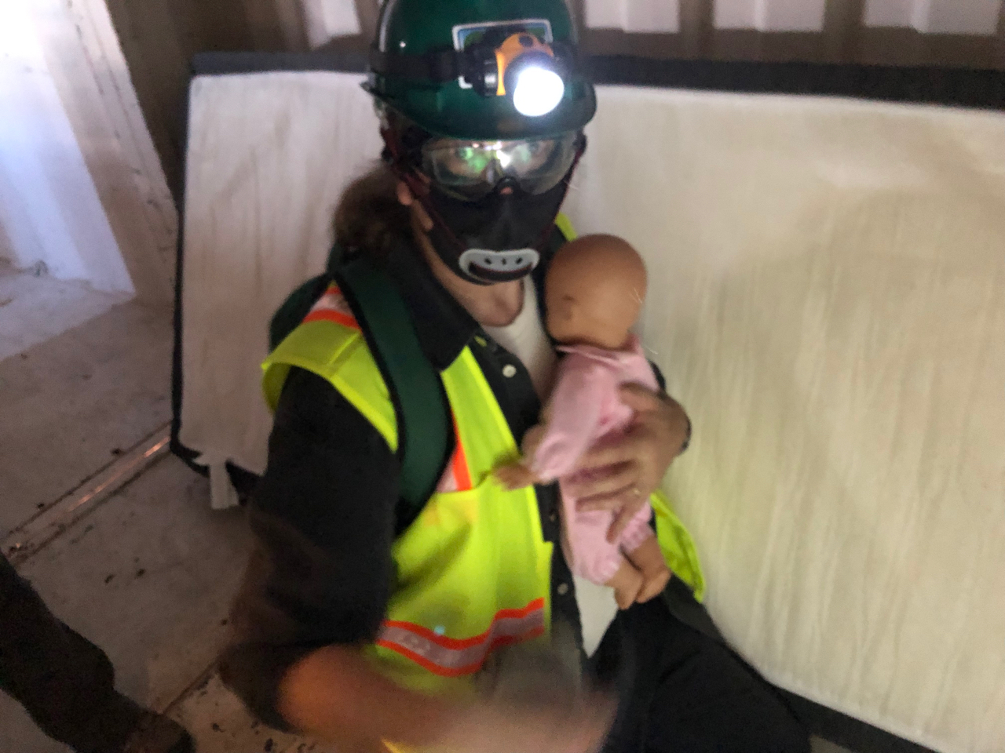
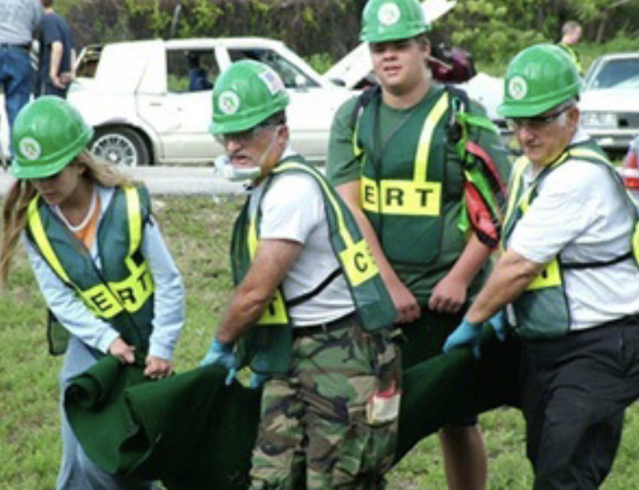
Search and Rescue
Consists of three separate operations
  Size-up: Using 9-step, continual model
  Search: Locating survivors and documenting
  Rescue: Extricating survivors
PM 7-1
CERT Basic Training Unit 7: Light Search and Rescue Operations
7-5

Slide 6
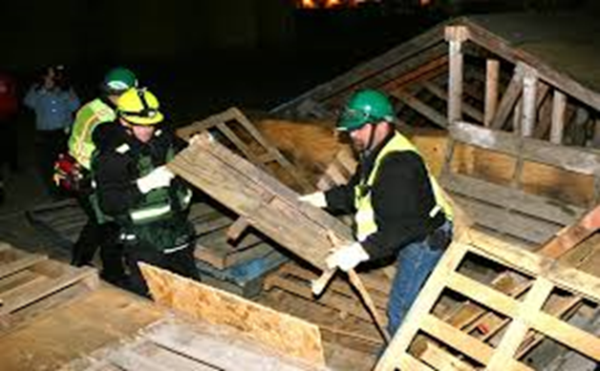
Deciding to Attempt Rescue
Decision based on three factors
  The risks involved for the rescuer and survivor
  Greatest good for the greatest number
  Resources and people available
PM 7-1
CERT Basic Training Unit 7: Light Search and Rescue Operations
7-6

Slide 7
Goals of Search and Rescue
Rescue greatest number in shortest amount of time
Get walking wounded out first
Rescue lightly trapped survivors next
Keep the rescuers and survivors safe
PM 7-1
CERT Basic Training Unit 7: Light Search and Rescue Operations
7-7

Slide 8
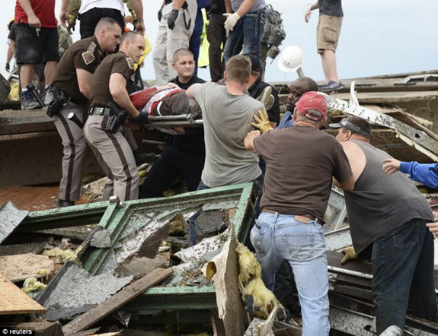
Effective Search and Rescue
Trapped victim survival rate
  Time of rescue Survival rate
    30 minutes 99.3%
    1 day 81.0%
    2 days 36.7%
    3 days 33.7%
    4 days 19.0%
    5 days 7.4%
CERT Basic Training Unit 7: Light Search and Rescue Operations
7-8

Slide 9
Effective Search and Rescue
Depends on:
  Effective size-up
  Available Resources
  Rescuer safety
  Survivor safety
  Rescuer Teamwork
  Continuous monitoring &
  communication
PM 7-1
CERT Basic Training Unit 7: Light Search and Rescue Operations
7-9
Notes:
Any questions on what will and will not be covered in this unit?

Slide 10
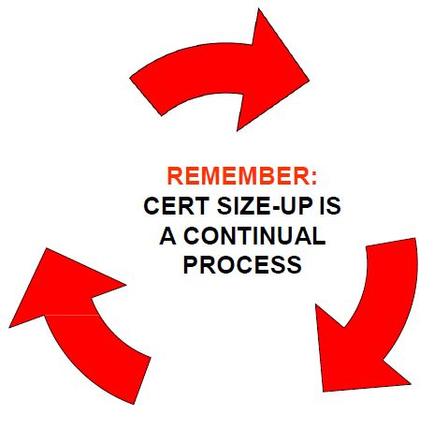
CERT Size-up
Gather Facts
Assess Damage
Consider Probabilities
Assess Your Situation
Establish Priorities
Make Decisions
Develop Plan of Action
Take Action
Evaluate Progress
PM 7-3
CERT Basic Training Unit 7: Light Search and Rescue Operations
7-10

Slide 11
Size-up Step 1
Gather Facts:
  Time of event and day of the week
  Construction type/terrain
  Occupancy
  Weather
  Hazards
  Search subject profile
PM 7-5
CERT Basic Training Unit 7: Light Search and Rescue Operations
7-11
Notes:
Use this picture for a practice of gathering facts

Slide 12
Scenario
Notes:
Imagine this building is in Santa Cruz, October 17, 5:04 PM. World Series beginning in SF.
During the Northridge earthquake in 1994, two concrete buildings collapsed catastrophically: a Bullock's department store and a Kaiser Permanente medical office in the San Fernando Valley. Hundreds could have died had the earthquake occurred during the workday, and not at 4:31 a.m.

Slide 13
Size-up Step 2
Assess and Communicate Damage
Survey entire perimeter to get full picture
Evaluate type of building construction
The CERT mission changes if:
  Damage is light
  Damage is moderate
  Damage is heavy
  [Recall Damage Assessment Form, Unit 2]
PM 7-6
CERT Basic Training Unit 7: Light Search and Rescue Operations
7-12

Slide 14
Light Damage
Superficial
Broken windows
Superficial cracks or
breaks in wall surface
Minor damage to the
interior contents
Safe to enter and remain
Triage and treat injured
in place
PM 7-6
CERT Basic Training Unit 7: Light Search and Rescue Operations
7-13

Slide 15
Moderate Damage
Visible signs of damage
Decorative work damaged or fallen
Many visible cracks or breaks in wall
Major damage to interior contents
Building still on foundation
Enter only to save lives,
triage, address life threats,
and evacuate
PM 7-6
CERT Basic Training Unit 7: Light Search and Rescue Operations
7-14

Slide 16
Heavy Damage
Partial or total collapse
Tilting
Obvious structural instability
Building off foundation
Smoke, fire, gas leaks, or hazardous material
Rising water
Do not enter a building with
heavy damage under any
circumstances!
PM 7-7
CERT Basic Training Unit 7: Light Search and Rescue Operations
7-15

Slide 17
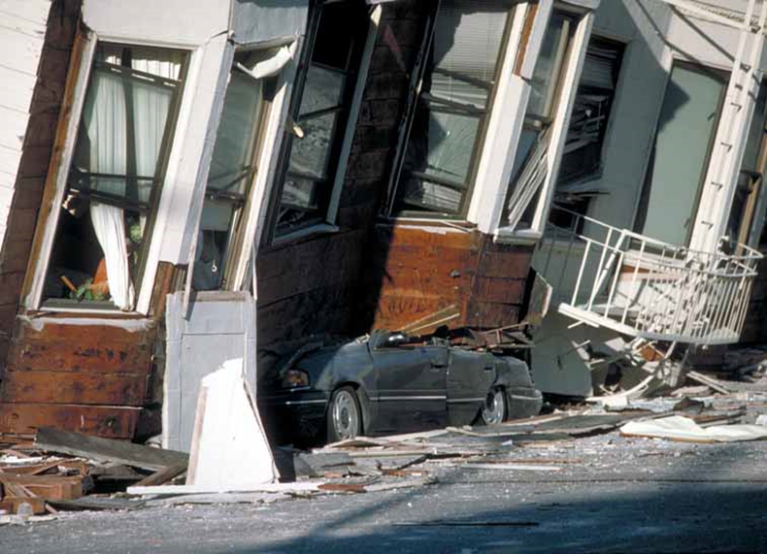
Identifying Structural Damage
Stay away from leaning buildings – there is a great possibility of a future collapse with an aftershock or from the weight of the building
CERT Basic Training Unit 7: Light Search and Rescue Operations
7-16
Notes:
LISTEN. If building is creaking or groaning, it is unstable. DO NOT ENTER.

Slide 18
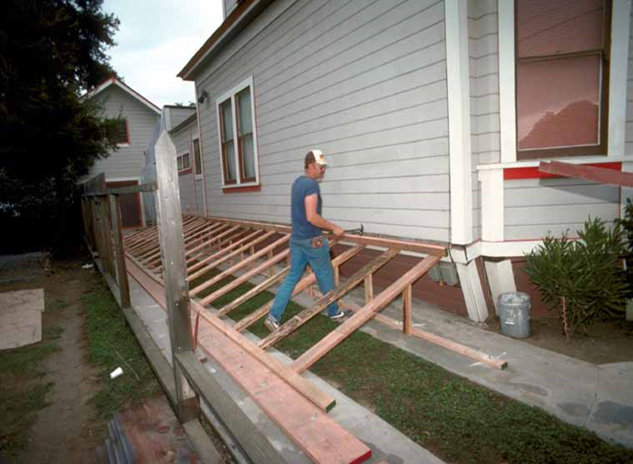
Identifying Structural Damage
Look for large cracks around:
  Foundation and or mud sills
  Garage doors
  Entry ways
Out-of-line cripple walls
CERT Basic Training Unit 7: Light Search and Rescue Operations
7-17

Slide 19
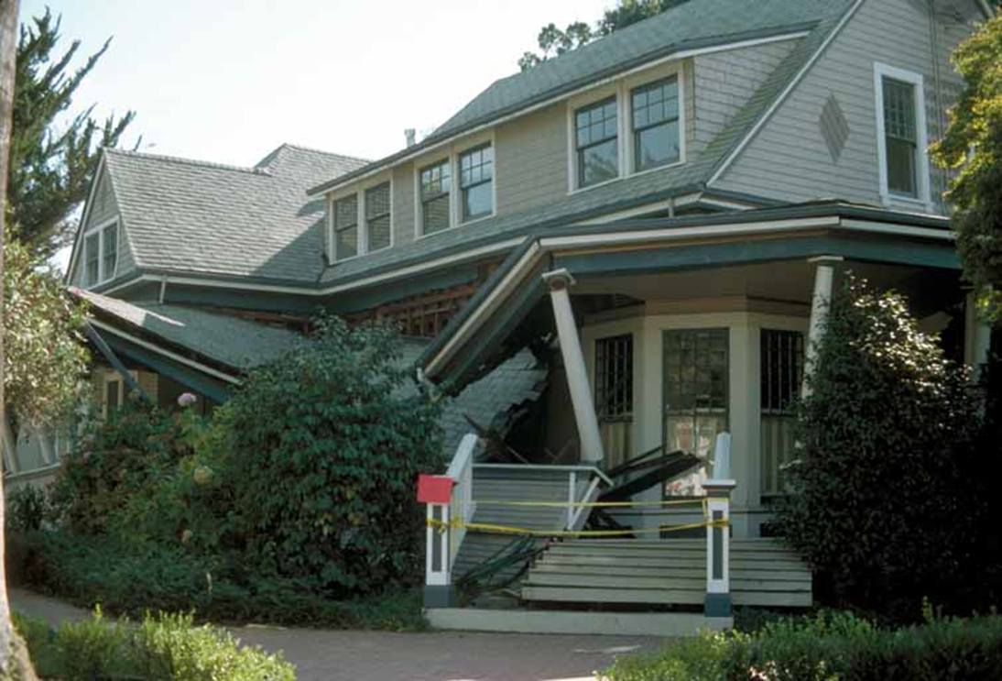
Structural Damage
CERT Basic Training Unit 7: Light Search and Rescue Operations
7-18
Notes:
What do you see? Would you enter?
What do you want to know before deciding to enter?
Describe damage using ABCD standard. A is front, Move clockwise, B is to the left, C is rear, etc. Use this also for inside hazards or survivors. Look at Table 7.2 on page 7-9.

Slide 20
Size-up Step 3
Consider Probabilities:
  How stable is the situation?
  What secondary factors should be considered?
  What else could go wrong?
  What does it mean for the search and rescue?
PM 7-8
CERT Basic Training Unit 7: Light Search and Rescue Operations
7-19
Notes:
Outside may look light or moderate but inside can pose dangers. Hazardous chemicals stored? Gas leaks? Unseen damage?
Secondary factors – Weather changing? Crowd growing? Sirens heard or silence?
What ifs? Power goes out during search, aftershocks. Apply Murphy’s law.
What does this mean? Spotter looking for changes, can you stabilize hazards? Personal safety first,

Slide 21
Size-up Step 4
Assess Your Situation:
  Is the situation safe enough to continue?
  What risks will rescuers face?
  What resources are needed?
  What resources are available?
PM 7-9
CERT Basic Training Unit 7: Light Search and Rescue Operations
7-20
Notes:
Resources will include personnel, tools, and equipment
Look at Table 7.3 on page 7-11

Slide 22
Rescue Resources
(If Available)
Personnel:
  Firefighters, Police
  Doctors, Nurses
  Contractors
Tools:
  Crowbars, Auto jacks
  Chainsaws
Equipment
  Bandages, flashlights, forms
PM 7-9
CERT Basic Training Unit 7: Light Search and Rescue Operations
7-21

Slide 23
Size-up Step 5
Establish Priorities:
  What should be done?
  In what order?
  How do you rescue the greatest number in the shortest amount of time?
PM 7-10
CERT Basic Training Unit 7: Light Search and Rescue Operations
7-22
Notes:
Priority determinations based on: 1) Safety of CERTs, 2) Life safety of survivors & others, 3) Protection of environment, 4) protection of property
EXAMPLE- Remove or mitigate hazards before attempting rescue. Greatest number in shortest time BUT NOT at the expense of your OWN SAFETY

Slide 24
Size-up Step 6
Make Decisions:
Keep in mind:
  Safety of CERT members
  Life safety for survivors and others
  Protection of the environment
  Protection of property
Communicate with CERT Operations Chief
  Actions, needed resources
PM 7-10
CERT Basic Training Unit 7: Light Search and Rescue Operations
7-23
Notes:
Alternate?? “Communicate with CERT Operations Chief and/or Fire Branch Manager”

Slide 25
Size-up Step 7
Develop Plan of Action:
  Focus operation on established priorities and decisions
  Provide documentation to give to responding agencies
  Provide documentation to become part of CERT and local government records
PM 7-11
CERT Basic Training Unit 7: Light Search and Rescue Operations
7-24
Notes:
CERT TL and planning develop the plan. Does not have to be written down, but if event is complex, written down plan helps focus your actions on established priorities, documentation for 1st responders, part of CERT’s record.

Slide 26
Size-up Step 8
Take Action:
Based on plan developed during Step 7
Be watchful for the unexpected
Document actions
PM 7-11
CERT Basic Training Unit 7: Light Search and Rescue Operations
7-25

Slide 27
Size-up Step 9
Evaluate Progress:
  Most critical step
  Monitor plan’s effectiveness and safety
PM 7-11
CERT Basic Training Unit 7: Light Search and Rescue Operations
7-26

Slide 28
Another acronym - CAN
Conditions
Actions
Necessities
PM 7-11
CERT Basic Training Unit 7: Light Search and Rescue Operations
7-26

Slide 29
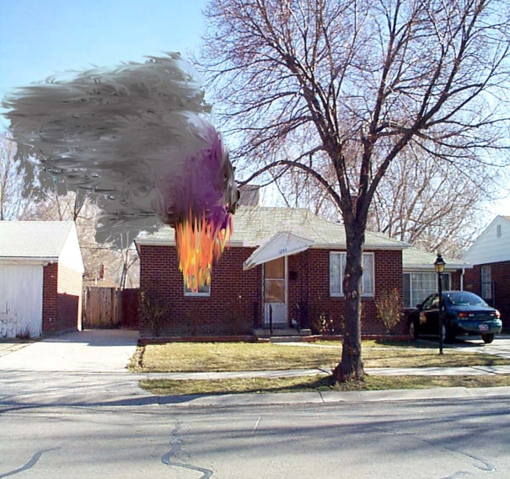
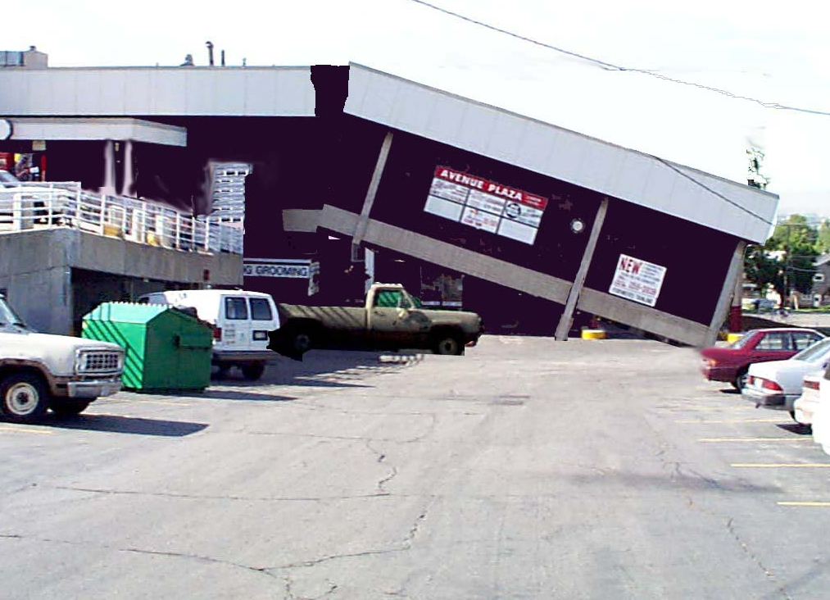
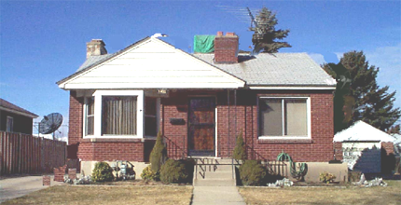
Prioritize (Greatest good!) 1 PM
Post earthquake, late October
  Moderately damaged house shifted off foundation; smell gas; report of invalid inside
  House on fire, fully involved
  Grocery store heavily damaged; report of at least 5 injured people carried to parking lot
PM 7-10
CERT Basic Training Unit 7: Light Search and Rescue Operations
7-22
Notes:
CERTs arrive at staging area with windshield survey/damage assessment forms. Class discussion of where you would go and why

Slide 30
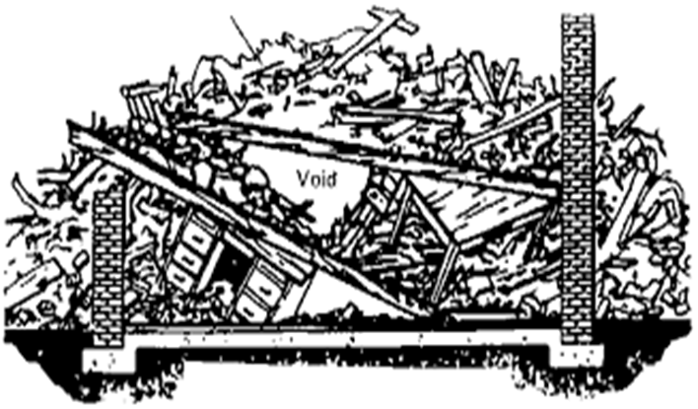
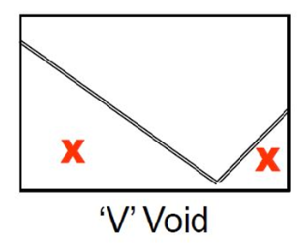
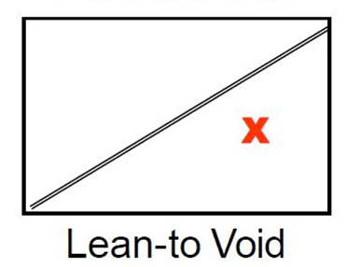
Structural Voids
If you see collapsed floors or walls, get out!
Pancake Void
X = Voids
PM 7-13
CERT Basic Training Unit 7: Light Search and Rescue Operations
7-27

Slide 31
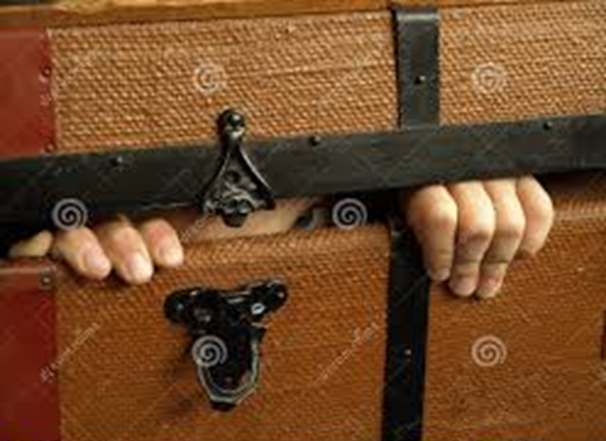
Individual Spaces
Survivors may seek protection in various places
  Inside bathtubs
  Underneath desks
  Inside cabinets
  Under/next to beds
  Inside closets
Children may be too frightened to respond
PM 7-13
CERT Basic Training Unit 7: Light Search and Rescue Operations
7-28

Slide 32
Utility Dangers
When approaching fallen or damaged utility wires, assume that all wires are charged (even phone & TV lines!)
If you smell gas as you enter the building, get out and shut the gas off
Only reenter the building when the smell of gas has disappeared
Safety is first priority!
CERT Basic Training Unit 7: Light Search and Rescue Operations
7-29

Slide 33
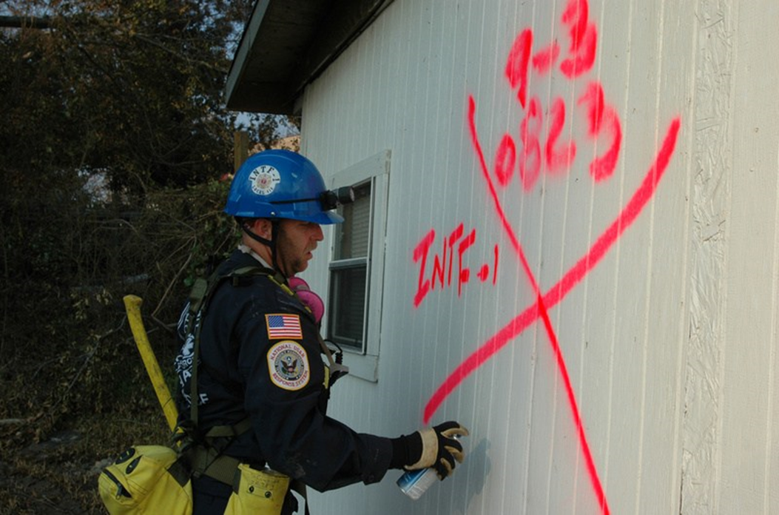
Search Markings (1 of 3)
CERT Basic Training Unit 7: Light Search and Rescue Operations
7-30

Slide 34

Search Markings (1 of 3)
Upon entering search area:
Write Date/Time In
Write Team ID
Date
Time In
CERT
I.D.
PM 7-14
CERT Basic Training Unit 7: Light Search and Rescue Operations
7-31

Slide 35
Search Markings (1 of 3)
Upon leaving search area:
Complete “X”
Write Time Out
List area searched
List if you found survivors / non-survivors and action taken
Date
Time In
Time Out
CERT
I.D.
Areas
Searched
Survivors / Non-survivors
PM 7-14
CERT Basic Training Unit 7: Light Search and Rescue Operations
7-32
Notes:
To remember, CERT can stand for Calendar (Date and time), Explore (areas searched), Rescued (survivors/non-survivors), Team (ID)

Slide 36



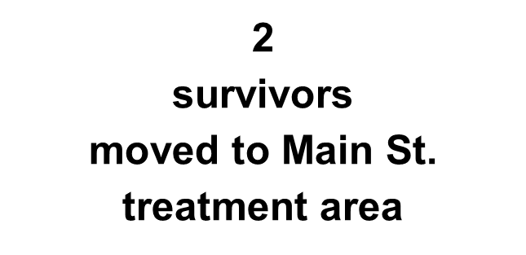
Search Markings (3 of 3)
Sample
8/15/20
In: 1430
Out: 1515
Floors 1-2 searched
Stairs to Floor -3 Unsafe, not searched
PM 7-14
CERT Basic Training Unit 7: Light Search and Rescue Operations
7-33

Slide 37
Search Methodology (1 of 5)
Voice Triage. Call out to survivors, “If anyone can hear my voice, come here.” Then stop frequently to listen.
Ask any survivors who respond for more information about the building or others who may be trapped
Survivors might be in shock or confused
Children tend to hide
PM 7-14
CERT Basic Training Unit 7: Light Search and Rescue Operations
7-34

Slide 38
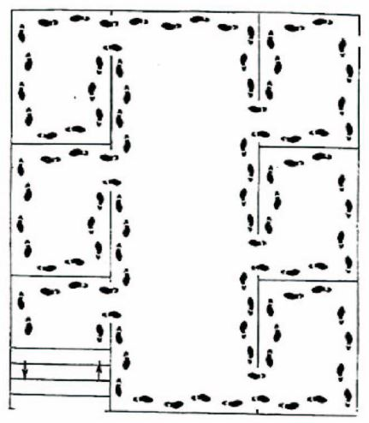
Search Methodology (2 of 5)
Bottom-up/top-down for a multi-story building
Right wall/left wall for a single floor
Stop frequently to listen
PM 7-15
CERT Basic Training Unit 7: Light Search and Rescue Operations
7-35

Slide 39
Search Methodology (3 of 5)
Stop frequently to listen for:
  Tapping
  Movement
  Voices
  Pet sounds
Move slowly, testing the floor
Look for hazards: below, side and above
Mark each individual apartment
Triangulate to locate hidden survivors
PM 7-15
CERT Basic Training Unit 7: Light Search and Rescue Operations
7-36

Slide 40
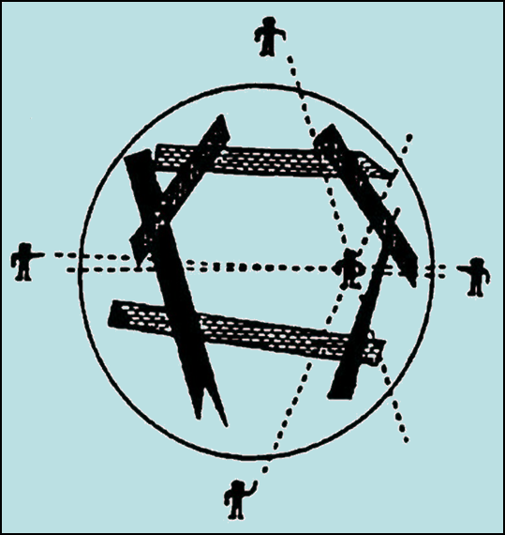
Search Methodology (4 of 5)
Triangulation allows rescuers to view a location from several perspectives
PM 7-15
CERT Basic Training Unit 7: Light Search and Rescue Operations
7-37

Slide 41
Search Methodology (5 of 5)
Keep records of rescued survivors and of those who remain trapped or are dead
Report information via chain of command: Squad to the CERT Operations Chief, who will report to the CERT Team Leader, to emergency services personnel
PM 7-15
CERT Basic Training Unit 7: Light Search and Rescue Operations
7-38
Notes:
*How do we reference Fire Branch Manager chain of command?

Slide 42

Exterior Search
Set up a grid search:
  Set distance between searchers according to visibility and debris
  Overlap patterns for full coverage
  Search in as straight a line as possible
  Mark areas that have been searched
PM 7-15
CERT Basic Training Unit 7: Light Search and Rescue Operations
7-39

Slide 43
Rescue Operations
Remove objects and debris to free survivors and create safe rescue environment
Triage survivors
Remove survivors
PM 7-17
CERT Basic Training Unit 7: Light Search and Rescue Operations
7-40

Slide 44
Creating a Safe Environment
Maintain rescuer safety
Triage survivors in lightly and moderately damaged buildings
Evacuate survivors as quickly as possible
PM 7-17
CERT Basic Training Unit 7: Light Search and Rescue Operations
7-41

Slide 45
Precautions to Minimize Risk
Know your limitations
Follow safety procedures
Remove debris by leveraging and cribbing
PM 7-17
CERT Basic Training Unit 7: Light Search and Rescue Operations
7-42

Slide 46
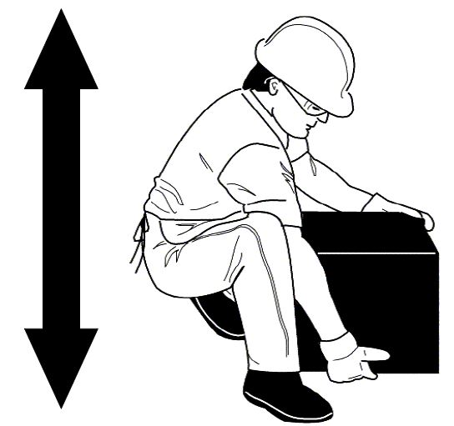
Proper Lifting Procedures
Back straight
Bend knees
Keep load close to body
Push up with legs
PM 7-18
CERT Basic Training Unit 7: Light Search and Rescue Operations
7-43

Slide 47
Leveraging and Cribbing
For heavy lifting
Performed in tandem
Helps extricate survivors
Various materials and objects may be used
PM 7-18
CERT Basic Training Unit 7: Light Search and Rescue Operations
7-44
Notes:
Next slide has embedded video demonstrating cribbing procedure. 6 minute video

Slide 48
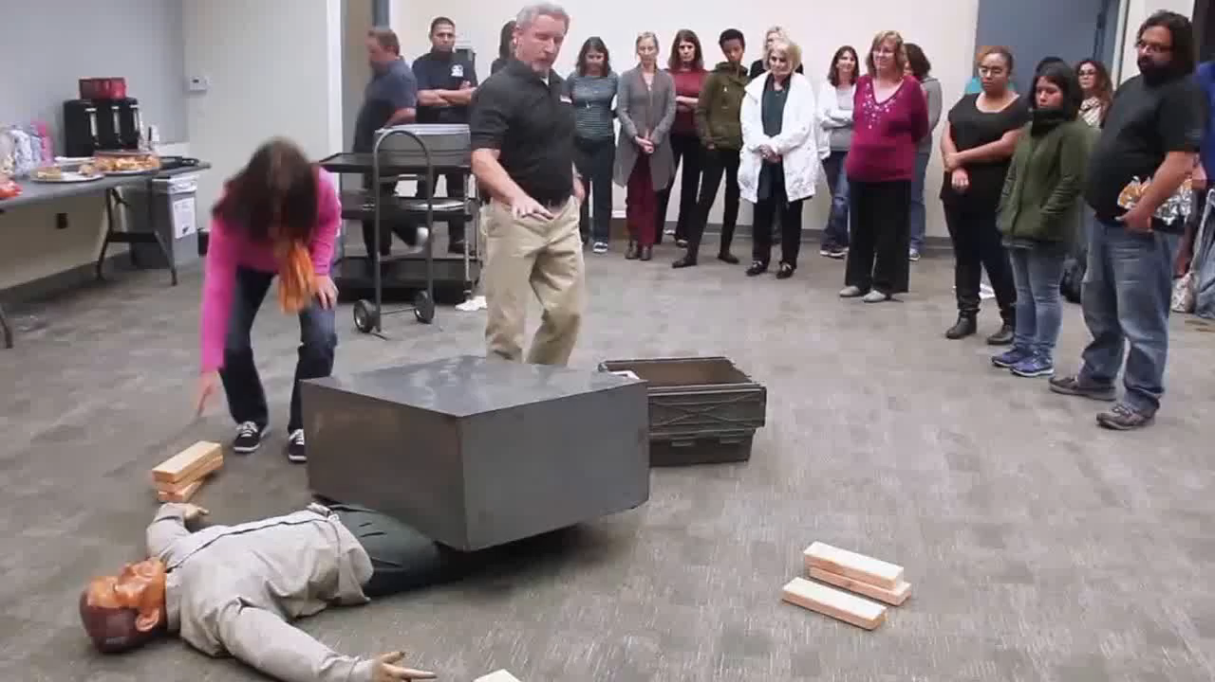
CERT Basic Training Unit 7: Light Search and Rescue Operations

Slide 49
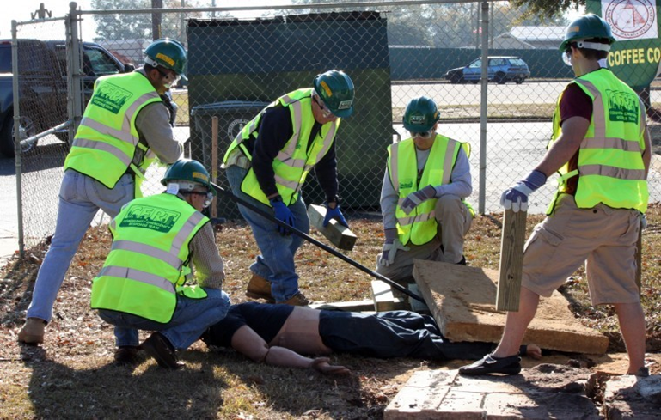
Role Assignments
1. Squad Leader (just out of frame)
Medical
Lever
Cribbing (2)
Safety Person
CERT Basic Training Unit 7: Light Search and Rescue Operations
7-45

Slide 50
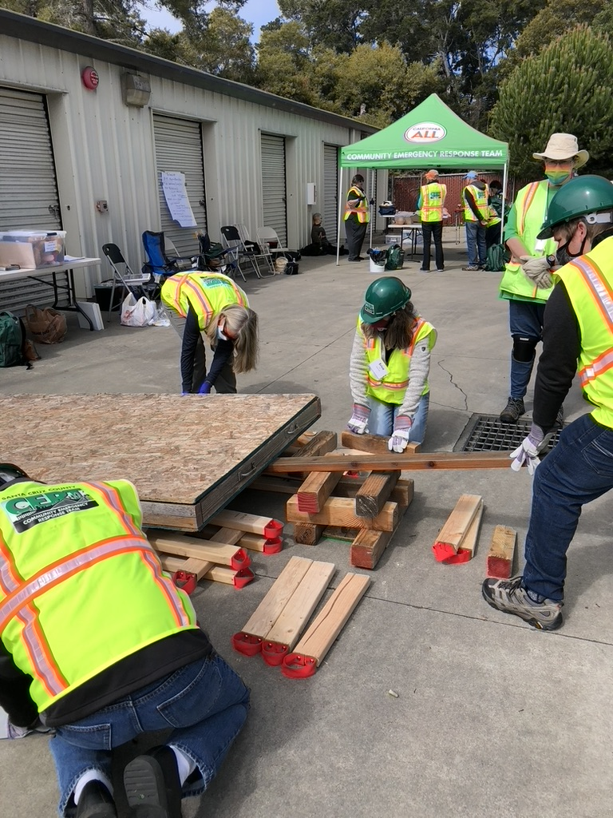
Leveraging and Cribbing
Confirm viable survivor
Place support under object to stabilize, without blocking the path
Lever with fulcrum
“Lift an inch, crib an inch”
Never reach under
Lower onto crib to test
Repeat to free survivor
CERT Basic Training Unit 7: Light Search and Rescue Operations
7-46

Slide 51
Two Types of Removal
Self removal or assist
Lifts and drags
PM 7-21
CERT Basic Training Unit 7: Light Search and Rescue Operations
7-47

Slide 52
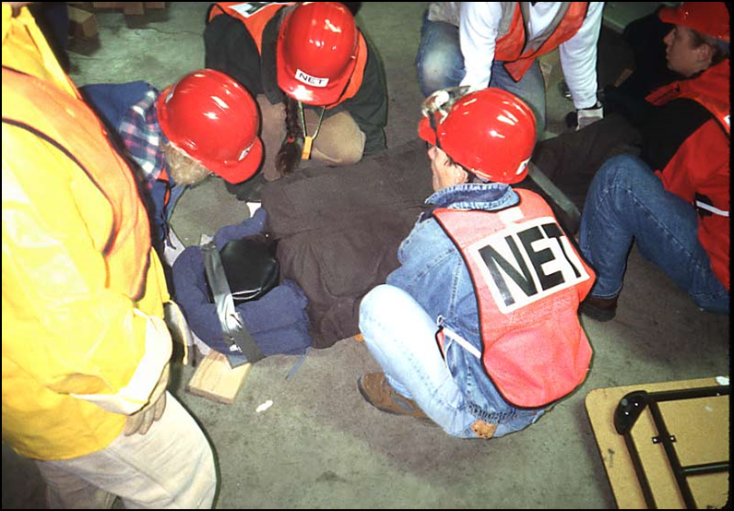
Extraction Method Factors
General stability of the immediate environment
Number of rescuers available
Strength and ability of the rescuers
Condition of survivor
PM 7-21
CERT Basic Training Unit 7: Light Search and Rescue Operations
7-48

Slide 53
One-Person Arm Carry
Lift around survivor’s back and under his or her knees
Lift survivor by keeping your own back straight and lifting with your legs
PM 7-21
CERT Basic Training Unit 7: Light Search and Rescue Operations
7-49

Slide 54
Pack-Strap Carry
PM 7-22
CERT Basic Training Unit 7: Light Search and Rescue Operations
7-50

Slide 55
Two-Person Carry
PM 7-22
CERT Basic Training Unit 7: Light Search and Rescue Operations
7-51

Slide 56
Chair Carry
PM 7-23
CERT Basic Training Unit 7: Light Search and Rescue Operations
7-52

Slide 57
Log Rolling
PM 7-25
CERT Basic Training Unit 7: Light Search and Rescue Operations
7-53

Slide 58
Blanket Carry
PM 7-24
CERT Basic Training Unit 7: Light Search and Rescue Operations
7-54

Slide 59
Blanket Drag
PM 7-25
CERT Basic Training Unit 7: Light Search and Rescue Operations
7-55

Slide 60
Unit Summary (Unit 7)
You should know
  How to perform search and rescue size-up
  How to decide whether to attempt rescue
  The objectives of interior and exterior search and rescue
  Building markings
  Rescue functions
  How to remove debris and how to crib
  How to remove survivors
PM 7-27
CERT Basic Training Unit 7: Light Search and Rescue Operations
7-56

Slide 61

Break)
Return at
_______
After Break:
Table Top
Exercise
CERT Basic Training Unit 7: Light Search and Rescue Operations
7-56

Slide 62
After Lunch(Unit 7)
Lunch Break. Return at ______ with CERT PPE on.
Practical Exercises– 2 rotations:
Fire Safety & Cribbing
Search and Rescue & Lifts/Carries
Unit 9, Review and Next Steps Information
Exam
Oath
Group Photo
CERT Basic Training Unit 7: Light Search and Rescue Operations
7-56
Notes:
Should this slide be here, or on it’s own after the table top exercise?

